Slide 1
Course Code: CSC211A Course Title: Formal Languages and Automata Theory
Lecture 11: More properties of Regular language -1
Course Leader:
Prakash P
prakashp.cs.et@msruas.ac.in

Slide 2
Session Objectives
At the end of this session, student will be able
Explain the properties of regular languages
Describe representation of regular languages
Understand non-regular languages

Slide 3
Session Topics
Properties of Regular Languages
Representation of Regular Languages
Non-Regular Languages

Slide 4
Already Proven
Regular languages are closed under:
Union
Concatenation
Star operation
Reverse

Slide 5
Properties of Regular Languages
Namely, for regular languages and :
Union
Concatenation
Star operation
Reverse
Regular
Languages

Slide 6
We will prove
Regular languages are closed under:
Complement
Intersection

Slide 7
Properties of Regular Languages
Namely, for regular languages and :
Complement
Intersection
Regular
Languages

Slide 8
Complement
Theorem:
For regular language the complement is regular
Proof:
Take DFA that accepts and make nonfinal
States, final final states nonfinal.
Resulting DFA accepts

Slide 9
Example

Slide 10
Intersection
Theorem:
For regular languages and
the intersection is regular
Proof:
Apply DeMorgan’s Law:

Slide 11
Properties of Regular Languages
regular
regular
regular
regular
regular

Slide 12
Standard Representations
of
Regular Languages

Slide 13
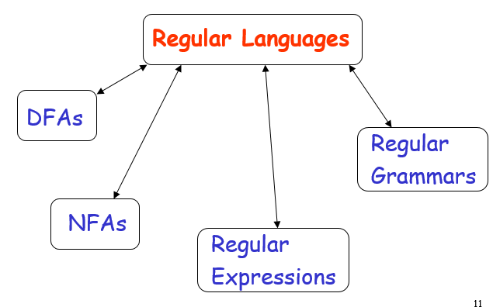
Standard Representations of Regular Languages

Slide 14
Representation of Regular Languages
When we say:
We are given a Regular Language
We mean:
Language is in a standard representation

Slide 15
Membership Question
Question:
Given regular language
and string
how can we check if ?
Answer:
Take the DFA that accepts
and check if is accepted

Slide 16
Representation of Regular Languages
DFA
DFA

Slide 17
Representation of Regular Languages
Question:
Given regular language how can we check if is empty: ?
Answer:
Take the DFA that accepts
Check if there is a path from
the initial state to a final state

Slide 18
Representation of Regular Languages
DFA
DFA

Slide 19
Representation of Regular Languages
Question:
Given regular language how can we check if is finite?
Answer:
Take the DFA that accepts
Check if there is a walk with cycle
from the initial state to a final state

Slide 20
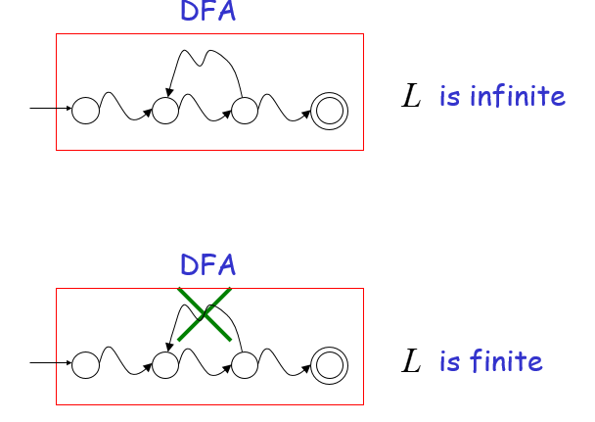
Representation of Regular Languages

Slide 21
Representation of Regular Languages
Question:
Given regular languages and
how can we check if ?
Answer:
Find if

Slide 22
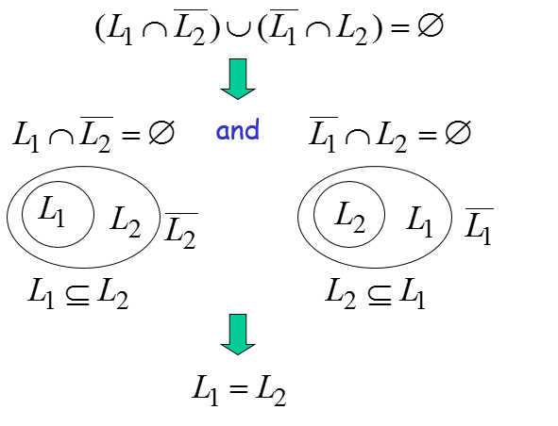
Representation of Regular Languages

Slide 23
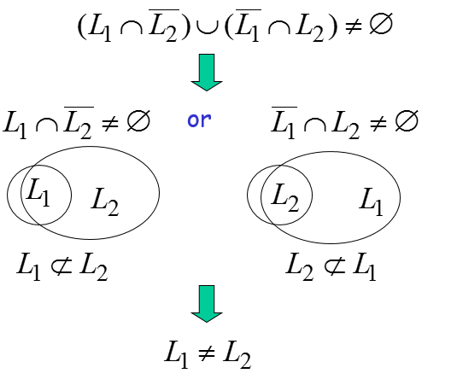
Representation of Regular Languages

Slide 24
Non-regular languages

Slide 25
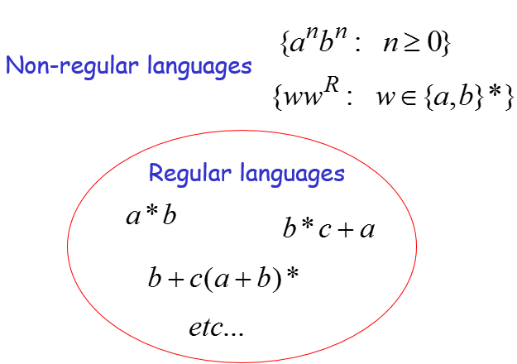
Non-Regular Languages

Slide 26
Non-Regular Languages
How can we prove that a language is not regular?
Prove that there is no DFA that accepts
Problem: this is not easy to prove
Solution: the Pumping Lemma !!!

Slide 27
Summary
Regular languages are closed under complement and intersection
The complement of a regular language is regular
Non regular languages are proved using pumping lemma

